Slide 1


Introduction to the practical training session
INTERNATIONAL AGENCY FOR RESEARCH ON CANCER LYON - FRANCE
e-SMP

Slide 2

Practical training session
GloboDiet version & exercises
GloboDiet training:
IARC, Lyon - France
Introduction exercises

Slide 3


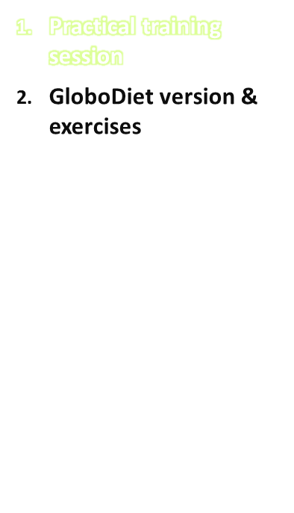
Aims:
  To practise all the theory presented during previous sessions using GloboDiet (GD) application
  To familiarise you with different search strategies, description and quantification methods for foods and recipes (incl. picture book)
  To practise inputting different types of recipes
  To make you aware of possible pitfalls and alternative ways of recording foods/recipes
  To obtain instant feedback in case of problems
Introduction exercises
IARC, Lyon - France
GloboDiet training:

Slide 4
Practical training session
Structure:
1st day: general exercises focusing on quick list and description and quantification of foods
Feedback regarding exercise 1
2nd day: exercises on recipes
Feedback regarding exercise 2
Perform extra exercises & homework
3rd day: discussion about the exercises and doubts/problems encountered
Short quiz to close the training session
GloboDiet training:
IARC, Lyon - France
Introduction exercises

Slide 5
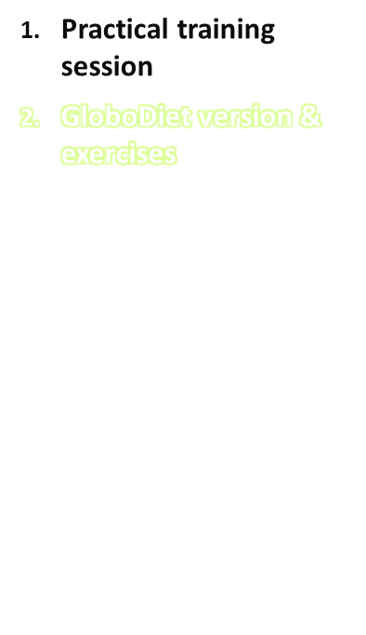
The local GloboDiet version will be used for the practical training session during the local training of the interviewers.
General exercises (as used in the train the trainer course), adapted to the local GloboDiet version will be made by the trainees.
Extra exercises adapted to the local situation/culture should be foreseen as well during the practical session of the local training
GloboDiet training:
IARC, Lyon - France
Introduction exercises

